Slide 1
Azure Cosmos DB Closing Session
<Speaker>

Slide 2

Demo: Toyota "O-Beya" multi-agent system
First, please take a look at this. This is the Toyota "O-Beya" multi-agent system we have developed.

Slide 3








TOYOTA Multi-Agent RAG Pattern
Easy to Deploy
Reliability and Performance
Mainly using
Big Data
Mainly using
Search
Agent API
Vector DB
Agent API
Agent API
Using AI Search connect with SharePoint
Embedding with AOAI Cosmos DB Vector Search
Cosmos DB Disk ANN
Agent API
Agent API
Agent API
Azure Functions
AOAI Extensions
Functions Flex Consumption

Slide 4
Multi-Agent using Durable Functions
Functions
Search
Batteries
Agent
SharePoint
Azure OpenAI Service
Cosmos DB
Durable Functions
Durable Functions
Functions
Cosmos DB
Motor
Agent
Vector DB
SharePoint
Azure OpenAI Service
Blob
Multi-Agent
Regulations Agent
Functions
AOAI
Cosmos DB
System Control Agent
Functions
AOAI
Cosmos DB

Slide 5
Announcement slide (dark) with color wipe
Azure Cosmos DB
The universe’s most
scalable
performant
cost-effective
flexible
database for AI apps

Slide 6
Announcement slide (dark) with color wipe
Azure Cosmos DB
For NoSQL
Serverless or Provisioned Throughput
Automatic data partitioning
Instant and dynamic autoscale
Low latency, real-time data transactions
Mission critical reliability (99.999%)
Built-in vector indexing and search w/ DiskANN
Zoom + fade

Slide 7
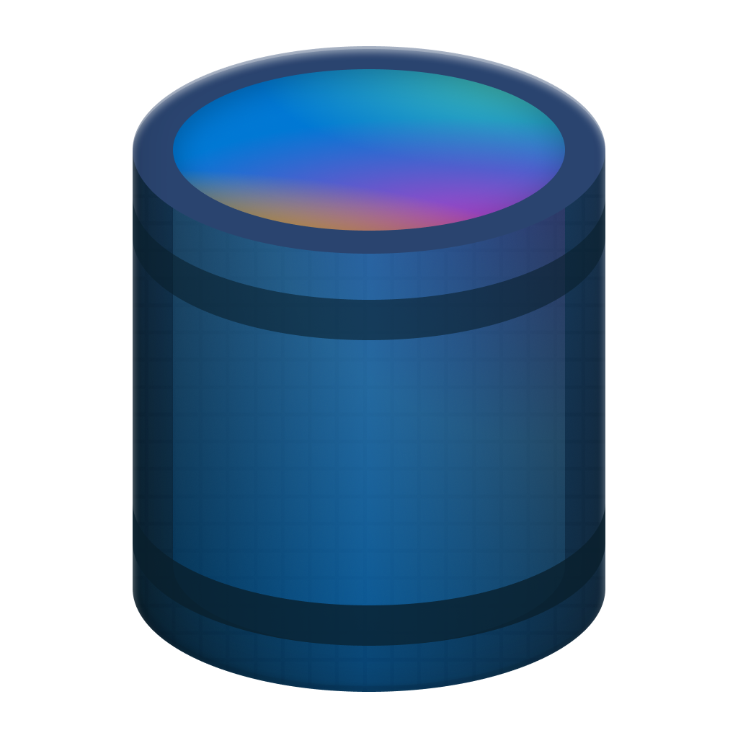
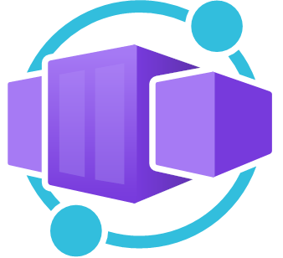

A Serverless Database for Any Application
Cost efficient & flexible
Start simply
Pay only for what you use
Low cost: $0.25 USD / 1M RUs
Easy to configure & manage
Great for multitenant apps, MVPs and development
Azure Serverless App Ecosystem

Slide 8








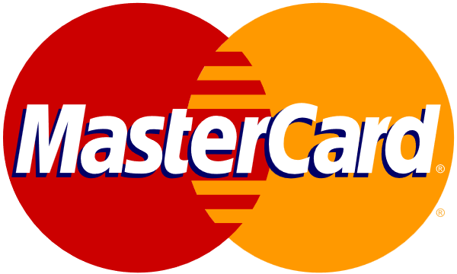



AI Use Cases with Azure Cosmos DB
Operational + Vector Database
Retrieval Augmented Generation (RAG)
Conversational History
Semantic Caching
AI Agents
No ETL
Consistent data
Reduce complexity & costs
Personalize LLM on your data
Cheaper than fine tuning
Faster iteration on new data
Conversational context
UX improvements
LLM optimizations
Auditing
Drastically reduces latency
Saves on Token consumption
Reduces costs and latency for LLM
Agent-to-agent transactions
Statefulness
Logging

Slide 9
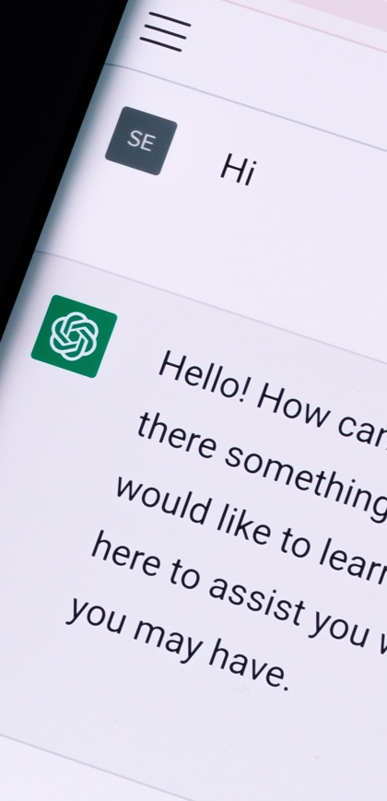


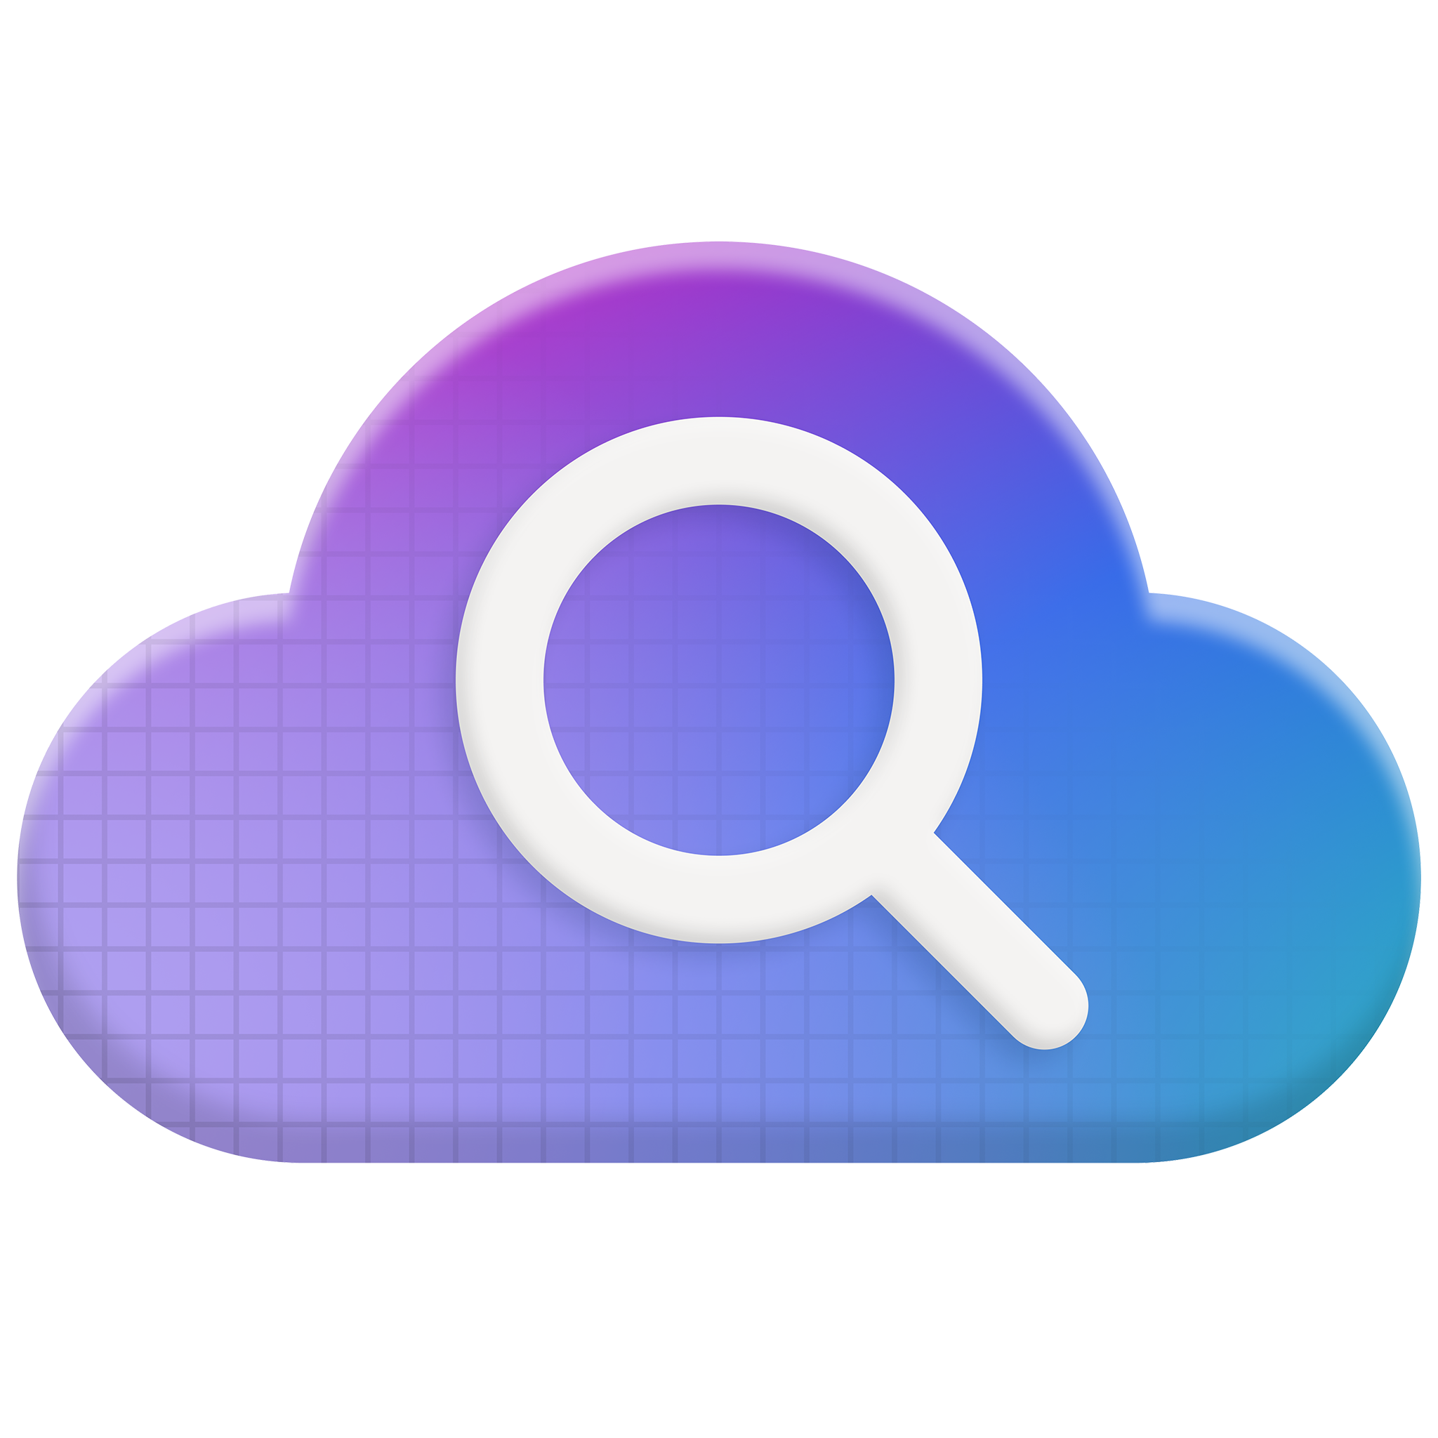
ChatGPT scales with Azure Cosmos DB
Open AI stores ChatGPT conversations and all other user interactions in Azure Cosmos DB, 40+ workloads
a
OpenAI
Challenge
Meet incredible demand from growth and traffic spikes, without having to worry about database operations
Outcomes
Rapidly and seamlessly scaled as service grew, with zero downtime
Able to iterate fast on data shapes thanks to schemaless flexibility
Consistent high performance and availability
Key Azure products used:
Azure Kubernetes Service
Azure Cosmos DB
Azure AI Search

Slide 10
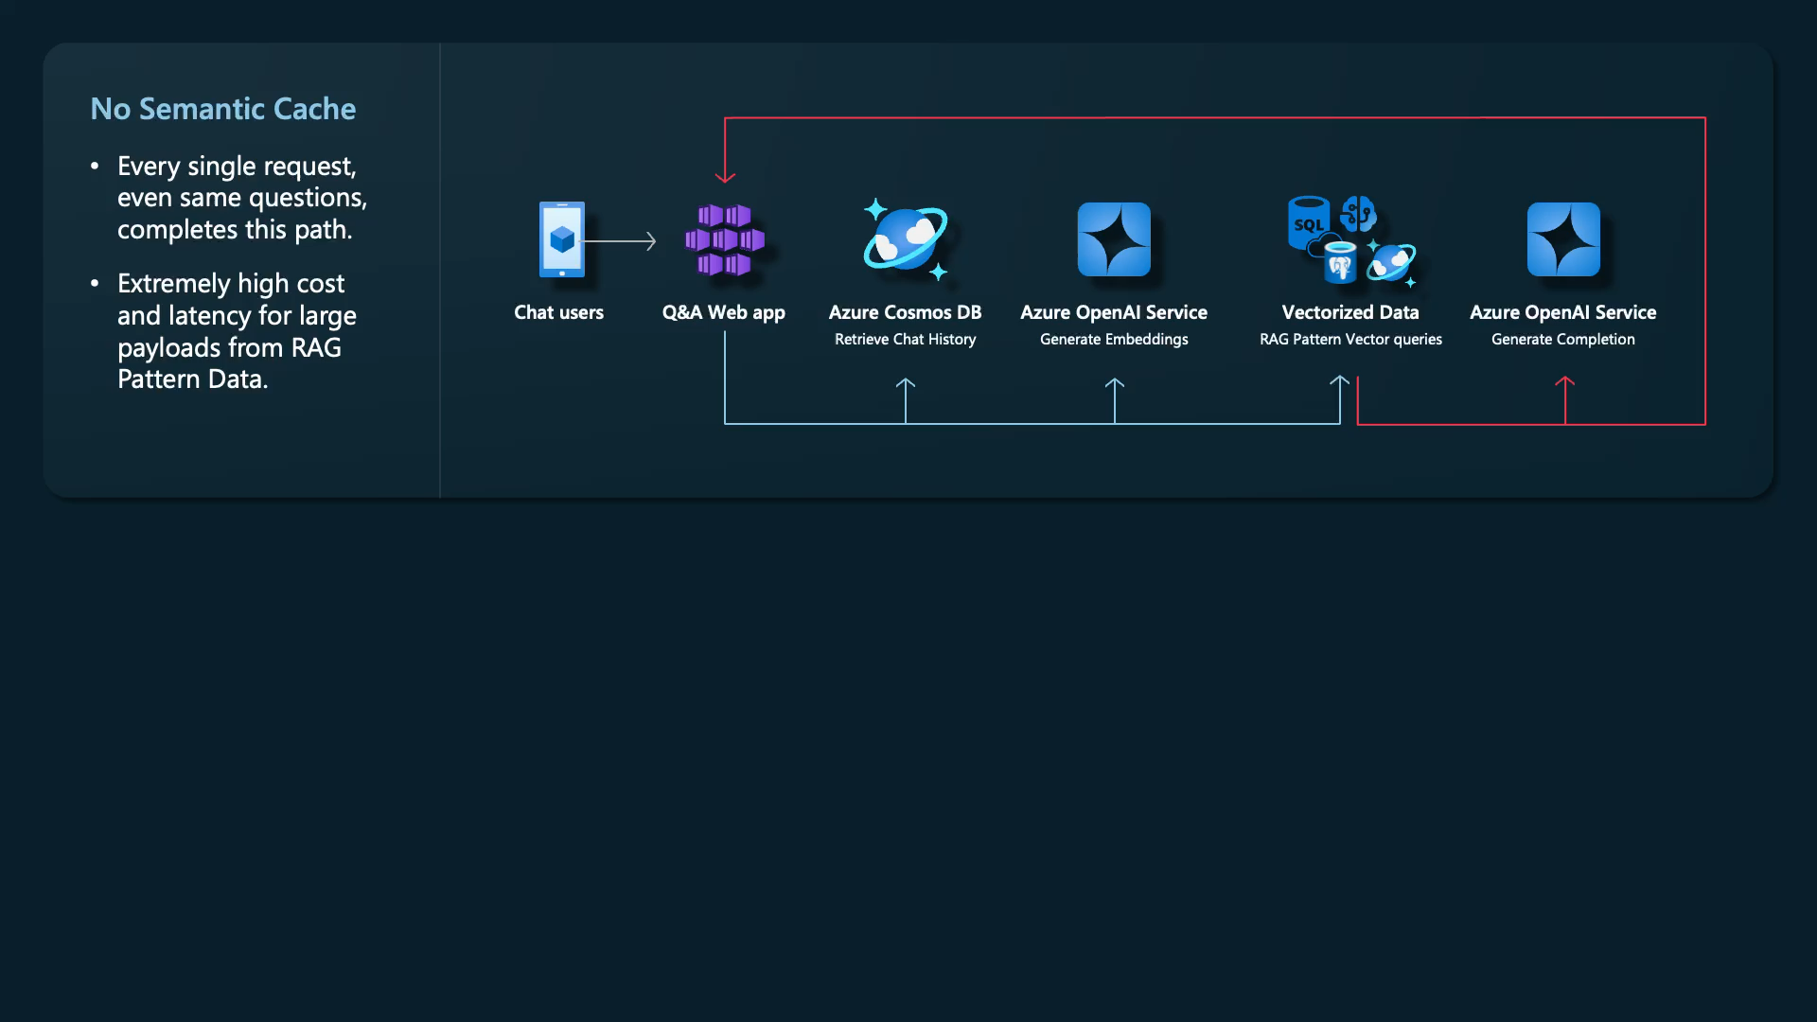
No Semantic Cache
Every single request, even same questions, completes this path.
Extremely high cost and latency for large payloads from RAG Pattern Data.

Slide 11
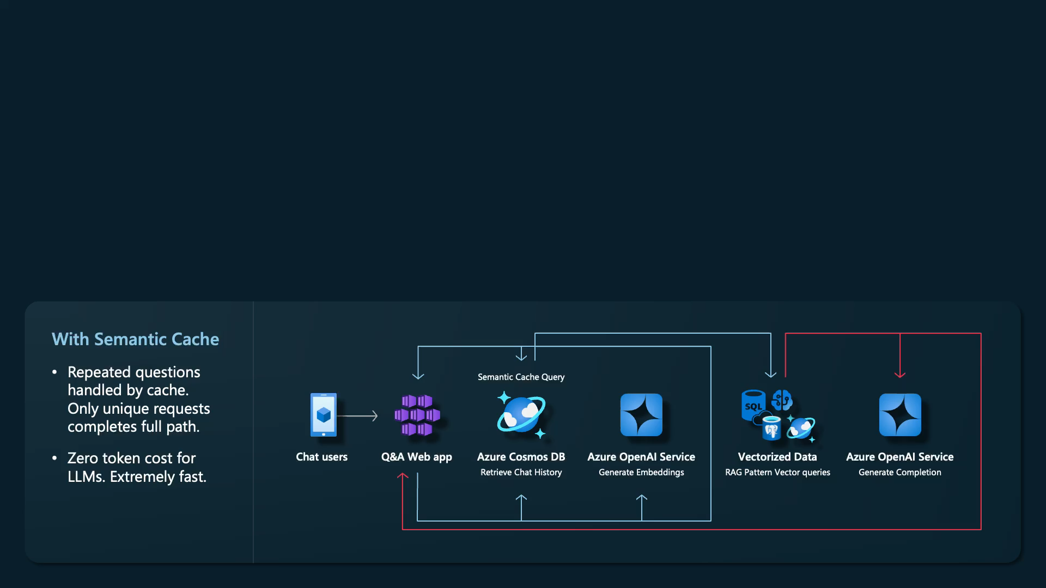
With Semantic Cache
Repeated questions handled by cache. Only unique requests completes full path.
Zero token cost for LLMs. Extremely fast.
No Semantic Cache
Every single request, even same questions, completes this path.
Extremely high cost and latency for large payloads from RAG Pattern Data.

Slide 12




Vector Search with Azure Cosmos DB
Performance improvements
More cost-effective, lower latency vector searches
Configurable vector indexes and search
Tune your own tradeoff between latency and accuracy
New compatibilities
Customer managed keys, Point-in-time-restore, Continuous Backup, Fabric mirroring
Changeable vector policies
Change data types, distance functions, paths, and vector indexes with ease
Rolling out to all Azure Public Cloud regions by January 2025

Slide 13
What you have learned today?
Azure Cosmos DB Fundamentals
- Environment setup, provisioning accounts, configuring indexing and partitioning, and SDK installation.
- Data modelling, partitioning strategies, schema design, and query tuning.
- Writing and optimising SQL queries, analysing RU consumption, and diagnosing performance bottlenecks.
AI Integration
- Implementing AI Agents with Cosmos DB, including full text, vector, and hybrid search.
- Building AI-powered search solutions and evaluating data modelling techniques for AI workloads.
Security & Cost Optimisation:
- Role-based access control (RBAC), private endpoints, encryption.
- Cost-saving strategies: autoscale, TTL, indexing tuning, and live optimisation in lab exercises.
Latest Innovations:
- Recent feature releases: burst capacity, hierarchical partitioning, integrated vector indexing.
- Recap of key learnings and open Q&A.

Slide 14
Thank you for participating! You are now equipped to build scalable, high-performance, and cost-optimised applications with Azure Cosmos DB

